Slide 1
DATA 468: Applied Stochastic Process
by
Dr. Zakir
Department of Mathematics University of Arizona
Email: zakir@arizona.edu

Slide 2
Outline
1. Markov chains
2. Stochastic chain/process
3. State Transition Matrix and Diagram
3. Transition probabilities
3
4
Notes:
https://bookdown.org/danielcavey27/lecture_notes/stochastic-process-and-markov-chains.html

Slide 3
Markov chains
In 1907 A. Markov defined and investigated a particular class of stochastic processes – Markov processes/chains
A stochastic process {X_{t}:t≥0} is a Markov chain if
To predict the future state of a Markov chain it is only important to know the present state and not how the process arrived at this state.
Notes:
https://www.stat.auckland.ac.nz/~fewster/325/notes/ch1annotated.pdf

Slide 4
Outline
1. Markov chains
2. Stochastic chain/process
3. State Transition Matrix and Diagram
3. Transition probabilities
3
4
Notes:
https://bookdown.org/danielcavey27/lecture_notes/stochastic-process-and-markov-chains.html

Slide 5
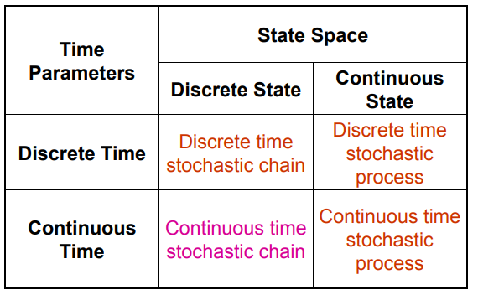
Categories of Stochastic Processes
weather model with 3 states:
Sunny
Cloudy
Rainy
Markov chain is a type of stochastic chain, but not all stochastic chains are Markov
Notes:
https://www.stat.auckland.ac.nz/~fewster/325/notes/ch1annotated.pdf

Slide 6
Markov chain and State Space
For a given outcome ω, the state at time t is X(t, ω).
If X(t, ω)=i, then we say the process is in state i.
Discrete-state process
{0, 1, 2,…} or {A, B, C,…}.
Continuous-state process
The state space contains finite or infinite intervals of the real number line.
The probability that stochastic process X takes on a value i (iЄ S ) at time = t is P[X(t)=i]
Notes:
https://www.stat.auckland.ac.nz/~fewster/325/notes/ch1annotated.pdf

Slide 7
Markov chain and State Space
State:
The weather condition at a particular time.
At time t=0, the state is Sunny.
At time t=3, the state might be Rainy.
Outcome (sample path):
One possible evolution of the weather.
Sunny→Cloudy→Rainy→Rainy→Sunny
State Space:
The set of all possible weather types in the model.
S={Sunny, Cloudy, Rainy}

Slide 8
Real World example
The probability of the weather tomorrow depends on the weather today, rather than the weather from the past.
Consider a simple weather model with two states: "Sunny" and "Rainy".
The probability of having a sunny day tomorrow depends only on whether it's sunny today, not on whether it was sunny or rainy the day before.
For example, if it's sunny today, there might be a 70% chance of it being sunny tomorrow and a 30% chance of it being rainy.
Similarly, if it's rainy today, there might be a 60% chance of it being rainy tomorrow and a 40% chance of it being sunny.
Notes:
https://www.stat.auckland.ac.nz/~fewster/325/notes/ch1annotated.pdf

Slide 9
Outline
1. Markov chains
2. Stochastic chain/process
3. State Transition Matrix and Diagram
3. Transition probabilities
3
4
Notes:
https://bookdown.org/danielcavey27/lecture_notes/stochastic-process-and-markov-chains.html

Slide 10
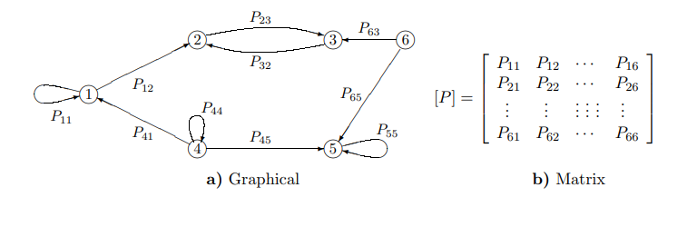
State Transition Matrix and Diagram
Transition probability matrix: These probabilities are typically represented in a matrix called the transition probability matrix.
Notes:
https://www.stat.auckland.ac.nz/~fewster/325/notes/ch8.pdf

Slide 11
State Transition Matrix and Diagram
The transition matrix is usually given the symbol P = (p_{ij}).
Entry (i, j) is the CONDITIONAL probability that NEXT = j, given that NOW = i: the probability of going FROM state i TO state j.
The rows of P should each sum to 1:
This simply states that X_{t+1} must take one of the listed values.
The columns of P do not in general sum to 1.
Notes:
https://www.stat.auckland.ac.nz/~fewster/325/notes/ch8.pdf

Slide 12
Outline
1. Markov chains
2. Stochastic chain/process
3. State Transition Matrix and Diagram
3. Transition probabilities
3
4
Notes:
https://bookdown.org/danielcavey27/lecture_notes/stochastic-process-and-markov-chains.html

Slide 13
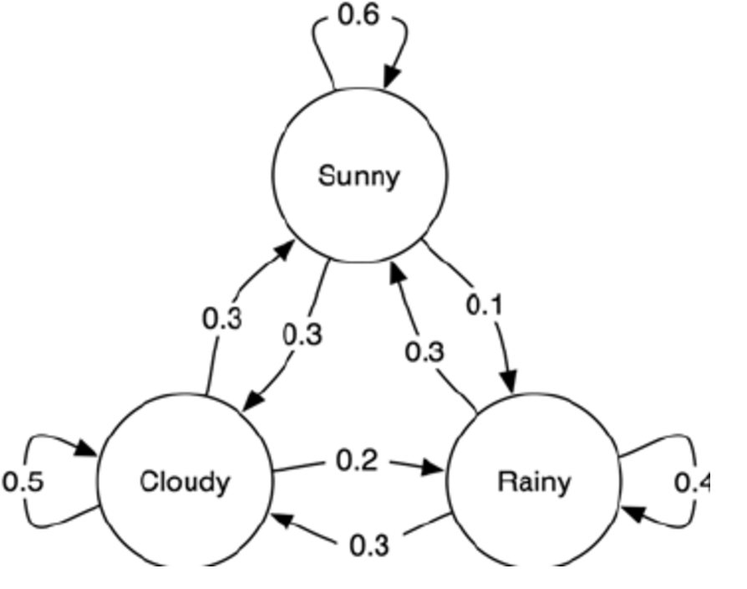
Transition probabilities
Transition probabilities: The likelihood of moving from one state to another in a single step.
Transition Diagram
Sunny:1 Rainy:2 Cloudy:3
Notes:
https://www.stat.auckland.ac.nz/~fewster/325/notes/ch1annotated.pdf
https://www.stat.auckland.ac.nz/~fewster/325/notes/ch8.pdf

Slide 14
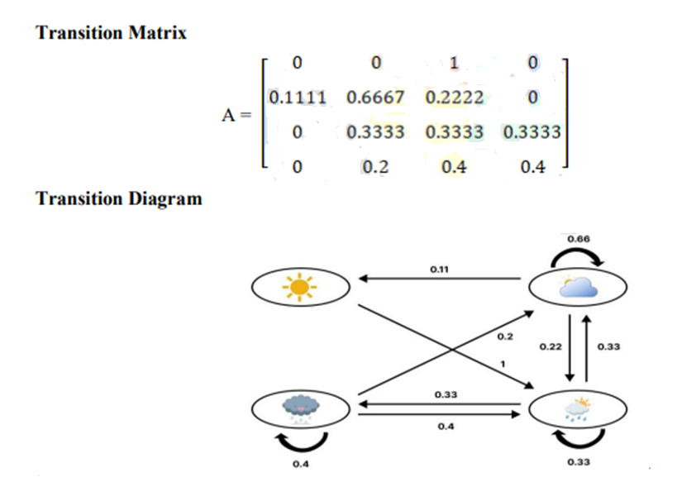
Markov chain: Transition probabilities
Notes:
https://www.stat.auckland.ac.nz/~fewster/325/notes/ch1annotated.pdf
Very nice: https://www.jetir.org/papers/JETIR2404922.pdf

Slide 15
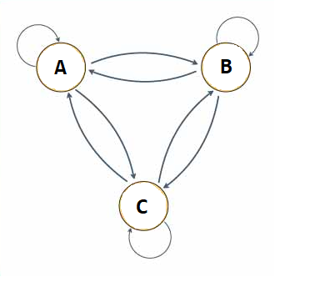
Supplementary reading: Markov Chain

